Slide 1
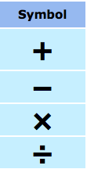





In your groups of 2-3, come up with everything you know about the following
mathematical terms:

Slide 2
24
7
30
Date
Introduction to Algebra
EQ – What are some of the keywords that I need to know when solving algebraic equations?
5

Slide 3
24
7
30
Date
Introduction to Algebra
EQ – What are some of the keywords that I need to know when solving algebraic equations?
Consider:
5

Slide 4
24
7
30
Date
Introduction to Algebra
EQ – What are some of the keywords that I need to know when solving algebraic equations?
Consider:
This is an algebraic equation. An equation is a statement
saying that “this equals that” or what is on the left side
(4x - 7) is equal to what is on the right (5)
5

Slide 5
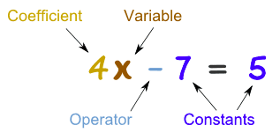
24
7
30
Date
Introduction to Algebra
EQ – What are some of the keywords that I need to know when solving algebraic equations?
Consider:
So that we can talk about equations, there are names for
the different parts (better than “that thingy there”, which
I’ve heard some of you say before!!!)
5

Slide 6
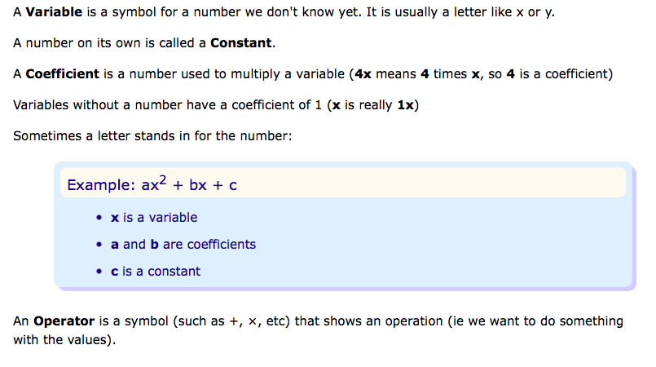
24
7
30
Date
Introduction to Algebra
EQ – What are some of the keywords that I need to know when solving algebraic equations?
5

Slide 7
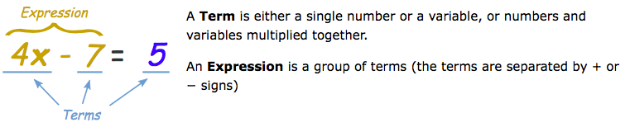
24
7
30
Date
Introduction to Algebra
EQ – What are some of the keywords that I need to know when solving algebraic equations?
Finally…
5

Slide 8
Algebraic Terms - Lesson 2
https://www.youtube.com/watch?v=BbX44YSsQ2I

Slide 9
24
7
30
Date
Simplifying Expressions
EQ – What is a ‘like term’ and how do I collect them?

Slide 10
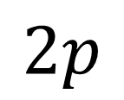

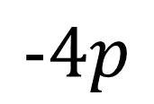
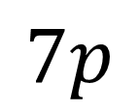
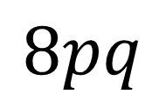
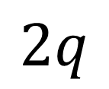
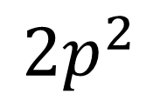
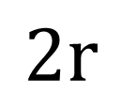
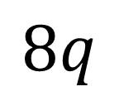
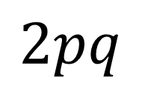
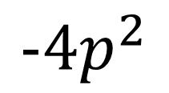
Match up the like terms

Slide 11
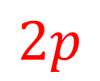
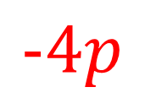
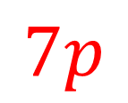
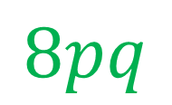
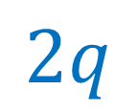
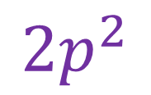

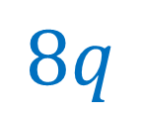
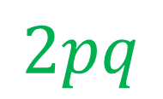
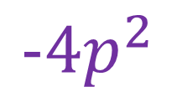
Match up the like terms

Slide 12
24
7
30
Date
Simplifying Expressions
EQ – What is a ‘like term’ and how do I collect them?
What are like terms?

Slide 13

24
7
30
Date
Simplifying Expressions
EQ – What is a ‘like term’ and how do I collect them?
Like terms contain exactly the same variables with the same powers. The variables do not need to be in the same order.
What are like terms?
How do I simplify expressions by collecting like terms?

Slide 14
24
7
30
Date
Simplifying Expressions
EQ – What is a ‘like term’ and how do I collect them?
Like terms contain exactly the same variables with the same powers. The variables do not need to be in the same order.
What are like terms?
How do I simplify expressions by collecting like terms?
**When adding and subtracting, the most important thing is
the variable (in this case t). The variables have to be the
same!

Slide 15

24
7
30
Date
Simplifying Expressions
EQ – What is a ‘like term’ and how do I collect them?
Like terms contain exactly the same variables with the same powers. The variables do not need to be in the same order.
What are like terms?
How do I simplify expressions by collecting like terms?
Identify like terms

Slide 16

24
7
30
Date
Simplifying Expressions
EQ – What is a ‘like term’ and how do I collect them?
Like terms contain exactly the same variables with the same powers. The variables do not need to be in the same order.
What are like terms?
How do I simplify expressions by collecting like terms?
Identify like terms
Simplify

Slide 17
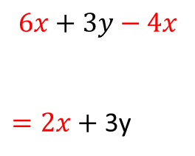
24
7
30
Date
Simplifying Expressions
EQ – What is a ‘like term’ and how do I collect them?
Like terms contain exactly the same variables with the same powers. The variables do not need to be in the same order.
What are like terms?
How do I simplify expressions by collecting like terms?
Identify like terms
Simplify

Slide 18
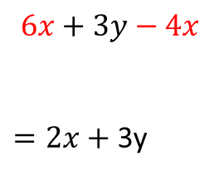

24
7
30
Date
Simplifying Expressions
EQ – What is a ‘like term’ and how do I collect them?
Like terms contain exactly the same variables with the same powers. The variables do not need to be in the same order.
What are like terms?
How do I simplify expressions by collecting like terms?
1.
2.
Identify like terms
Simplify
3.
Identify like terms
Simplify

Slide 19

24
7
30
Date
Simplifying Expressions
EQ – What is a ‘like term’ and how do I collect them?
Like terms contain exactly the same variables with the same powers. The variables do not need to be in the same order.
What are like terms?
How do I simplify expressions by collecting like terms?
1.
2.
Identify like terms
Simplify
3.
Identify like terms
Simplify

Slide 20

24
7
30
Date
Simplifying Expressions
EQ – What is a ‘like term’ and how do I collect them?
Like terms contain exactly the same variables with the same powers. The variables do not need to be in the same order.
What are like terms?
How do I simplify expressions by collecting like terms?
1.
2.
Identify like terms
Simplify
3.
Identify like terms
Simplify

Slide 21

24
7
30
Date
Simplifying Expressions
EQ – What is a ‘like term’ and how do I collect them?
Like terms contain exactly the same variables with the same powers. The variables do not need to be in the same order.
What are like terms?
How do I simplify expressions by collecting like terms?
1.
2.
Identify like terms
Simplify
3.
Identify like terms
Simplify

Slide 22
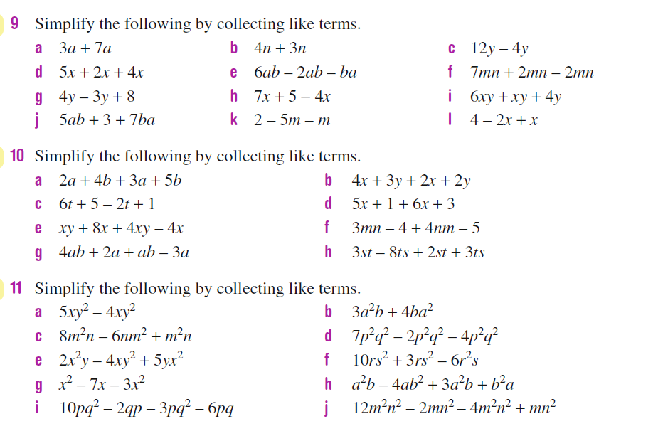
Task

Slide 23
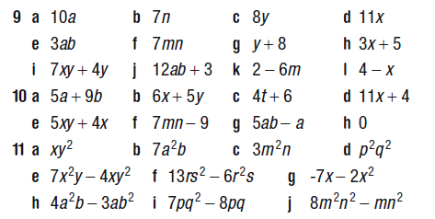
Answers

Slide 24
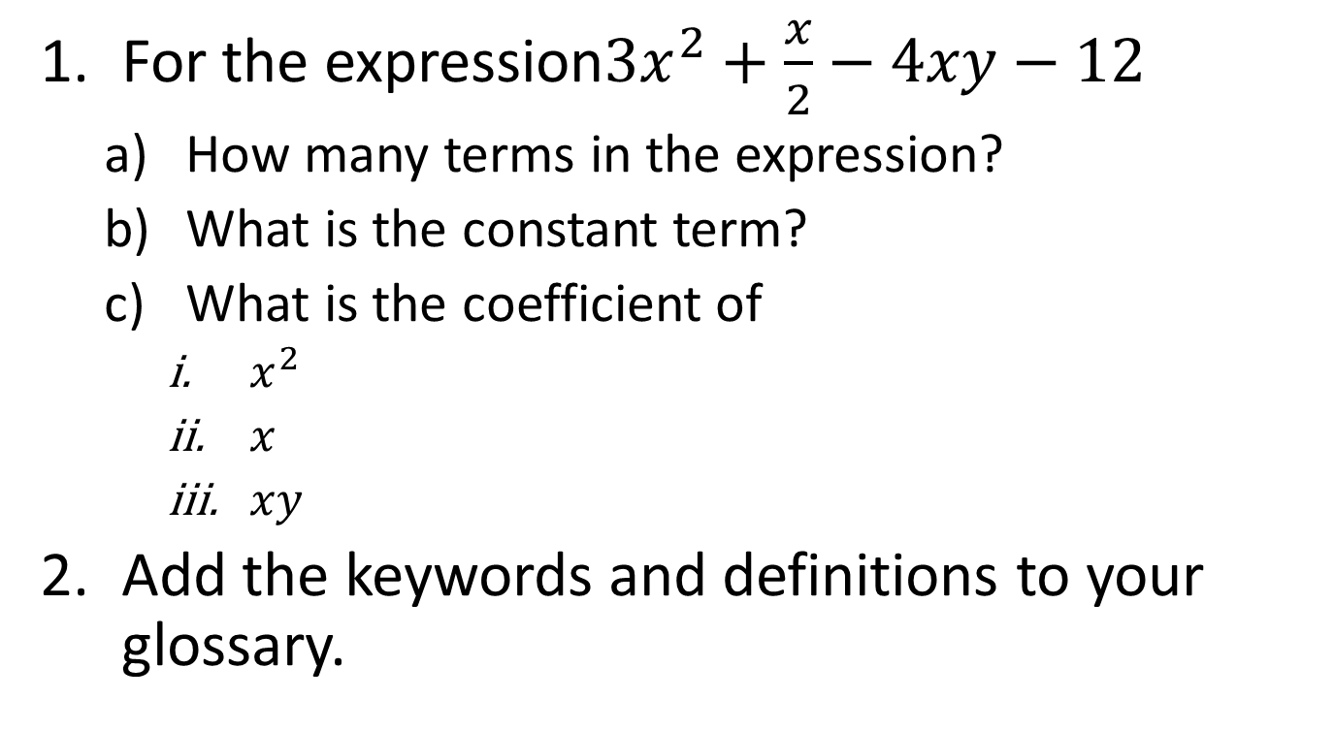
Task

Slide 25
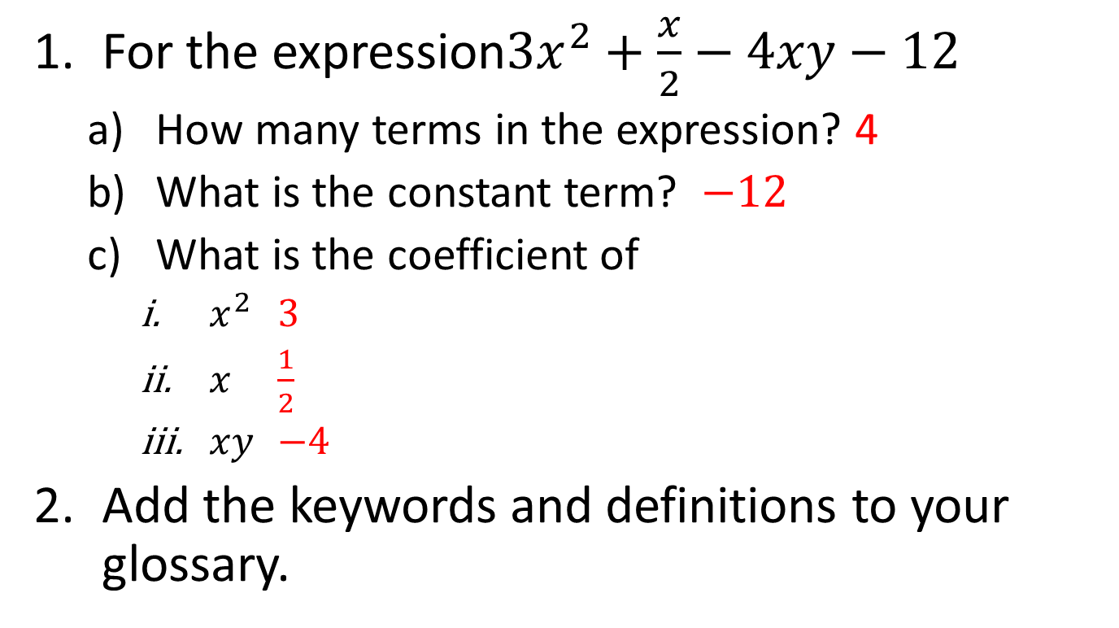
Task

Slide 26
Notes Review
24, 7 ,30
Date
Title
Essential question
Notes complete
Notes complete with colour and diagrams
Questions completed
Contents page filled in
Formula page filled in

Slide 27
Homework
Review your notes and write a summary answering the essential question.

